Slide 1
第七讲 Android事件手势及其处理

Slide 2
用户在使用手机和平板电脑时，是通过各种操作来和软件进行交互，较常见的方式包括物理按键操作，触摸操作和手势等。
在Android中，这些操作都将转换为对应的事件进行处理。

Slide 3
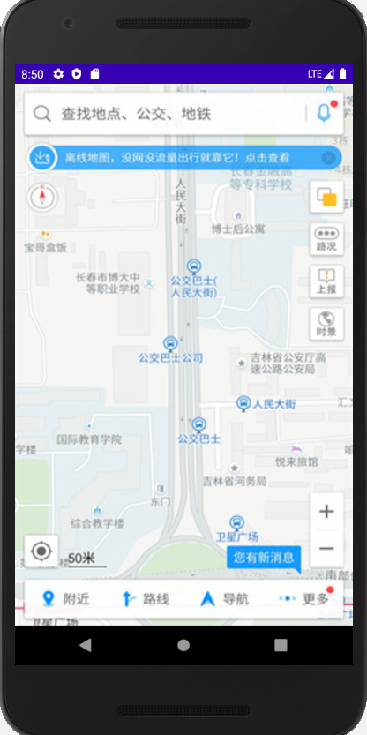
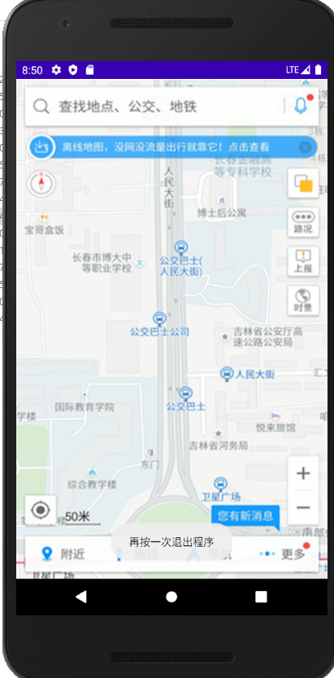
模拟退出地图应用

Slide 4
activity_main.xml
<?xml version="1.0" encoding="utf-8"?>
<RelativeLayout
xmlns:android="http://schemas.android.com/apk/res/android"
xmlns:tools="http://schemas.android.com/tools"
android:layout_width="match_parent"
android:layout_height="match_parent"
android:background="@drawable/gaode"
tools:context=".MainActivity">
</RelativeLayout>

Slide 5
package nchu.bme.keytest;
import android.app.Activity;
import android.os.Bundle;
import android.view.KeyEvent;
import android.widget.Toast;

Slide 6
public class MainActivity extends Activity {
private long exitTime = 0; //退出时间变量值
@Override
protected void onCreate(Bundle savedInstanceState) {
super.onCreate(savedInstanceState);
setContentView(R.layout.activity_main);
}
@Override
public boolean onKeyDown(int keyCode, KeyEvent event) {
if (keyCode == KeyEvent.KEYCODE_BACK) {
exit(); //创建并调用退出方法
return true;
}
return super.onKeyDown(keyCode, event);
}

Slide 7
public void exit() {
if ((System.currentTimeMillis() - exitTime) > 2000) {
//计算按键时间差是否大于两秒，大于两秒就再次弹出
Toast.makeText(getApplicationContext(),
“再按一次退出程序”, Toast.LENGTH_SHORT).show();
exitTime = System.currentTimeMillis();
} else //小于两秒就退出
{
finish();
System.exit(0); //销毁强制退出
}
}
}

Slide 8
触摸屏事件处理
目前Android手机，平板电脑都以较大的屏幕取代了外置键盘，很多操作都是通过触摸屏来实现的。
常用的触摸屏事件主要包括单击事件，长按事件和触摸事件等。

Slide 9
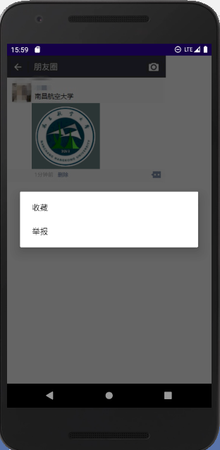
举例：模拟长按朋友圈图片弹出菜单功能

Slide 10
<?xml version="1.0" encoding="utf-8"?>
<LinearLayout
xmlns:android="http://schemas.android.com/apk/res/android"
xmlns:tools="http://schemas.android.com/tools"
android:layout_width="match_parent"
android:layout_height="match_parent"
android:orientation="vertical"
tools:context=".MainActivity">
<ImageView
android:layout_width="wrap_content"
android:layout_height="wrap_content"
android:src="@drawable/wei_top"/>
<ImageView
android:id="@+id/imageView"
android:layout_width="wrap_content"
android:layout_height="wrap_content"
android:layout_marginLeft="50dp"
android:src="@drawable/ico_144_144a"/>
<ImageView
android:layout_width="wrap_content"
android:layout_height="wrap_content"
android:src="@drawable/wei_down"/>
</LinearLayout>

Slide 11
package nchu.bme.longpresstest;
import androidx.appcompat.app.AppCompatActivity;
import android.app.Activity;
import android.media.Image;
import android.os.Bundle;
import android.view.ContextMenu;
import android.view.View;
import android.widget.ArrayAdapter;
import android.widget.ImageView;
import android.widget.ListView;
import android.widget.Toast;
import java.util.ArrayList;
import java.util.List;
public class MainActivity extends Activity {
@Override
protected void onCreate(Bundle savedInstanceState) {
super.onCreate(savedInstanceState);
setContentView(R.layout.activity_main);
ImageView imageView = (ImageView) findViewById(R.id.imageView);

Slide 12
imageView.setOnLongClickListener(new View.OnLongClickListener(){
@Override
public boolean onLongClick(View v) {
registerForContextMenu(v); //将长按事件注册菜单中
openContextMenu(v); //打开菜单
return true;
}
});
}
@Override
public void onCreateContextMenu(ContextMenu menu, View v,
ContextMenu.ContextMenuInfo menuInfo) {
super.onCreateContextMenu(menu, v, menuInfo);
menu.add("收藏");
menu.add("举报");
}
}

Slide 13
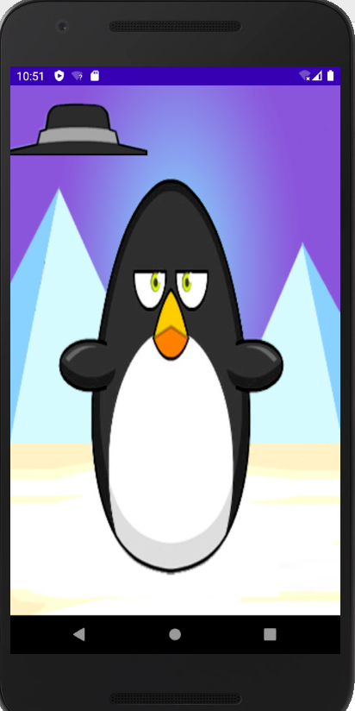
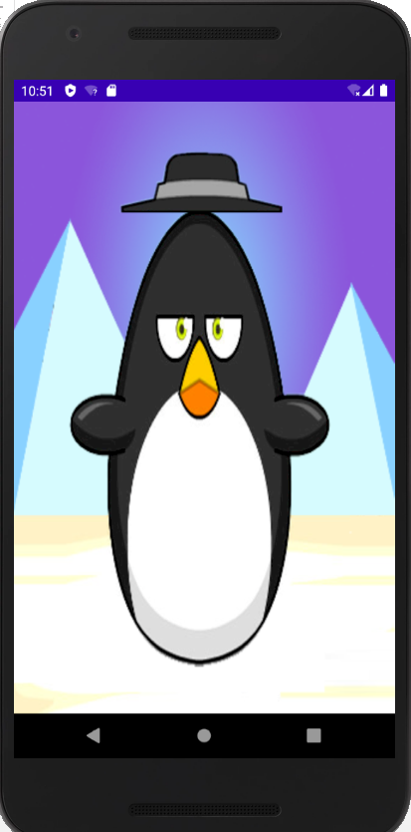
企鹅戴帽

Slide 14
activity_main.xml
<?xml version="1.0" encoding="utf-8"?>
<RelativeLayout
xmlns:android="http://schemas.android.com/apk/res/android"
xmlns:tools="http://schemas.android.com/tools"
android:id="@+id/relativeLayout"
android:layout_width="match_parent"
android:layout_height="match_parent"
android:background="@drawable/background"
tools:context=".MainActivity">
</RelativeLayout>

Slide 15
MainActivity.java
package nchu.bme.wearhat;
import android.app.Activity;
import android.os.Bundle;
import android.view.MotionEvent;
import android.view.View;
import android.widget.RelativeLayout;
public class MainActivity extends Activity {
@Override
protected void onCreate(Bundle savedInstanceState) {
super.onCreate(savedInstanceState);
setContentView(R.layout.activity_main);
//获取相对局管理器

Slide 16
RelativeLayout relativeLayout = (RelativeLayout) findViewById(R.id.relativeLayout);
final HatView hat = new HatView(MainActivity.this);
hat.setOnTouchListener(new View.OnTouchListener() {
@Override
public boolean onTouch(View v, MotionEvent event) {
hat.bitmapX = event.getX(); //设置帽子显示位置的X坐标
hat.bitmapY = event.getY(); //设置帽子显示位置的Y坐标
hat.invalidate(); //重绘hat组件
return true;
}
});
relativeLayout.addView(hat); //将hat添加到布局管理器中
}
}

Slide 17
HatView.java
package nchu.bme.wearhat;
import android.content.Context;
import android.graphics.Bitmap;
import android.graphics.BitmapFactory;
import android.graphics.Canvas;
import android.graphics.Paint;
import android.view.View;
public class HatView extends View {
public float bitmapX; // 帽子显示位置的X坐标
public float bitmapY; // 帽子显示位置的Y坐标
public HatView(Context context) {//重写构造方法
super(context);
bitmapX = 65; // 设置帽子的默认显示位置的X坐标
bitmapY = 0; // 设置帽子的默认显示位置的Y坐标
}
@Override
protected void onDraw(Canvas canvas) {
super.onDraw(canvas);
Paint paint = new Paint(); //创建Paint对象
//根据图片生成位图对象
Bitmap bitmap = BitmapFactory.decodeResource(this.getResources(),R.drawable.hat);
canvas.drawBitmap(bitmap, bitmapX, bitmapY, paint); // 绘制帽子
if (bitmap.isRecycled()) { // 判断图片是否回收
bitmap.recycle(); // 强制回收图片
}
}
}

Slide 18
手势检测
手势是指用户手指或触摸笔在屏幕上的连续触碰行为。
例如，在屏幕上从左到右或从上到下划出的一个动作就是手势。
Android为手势行为提供了支持，最常用的就是手势检测。

Slide 19
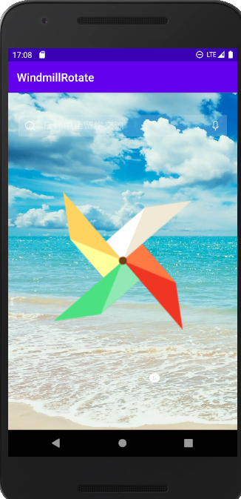
举例：通过手势检测实现风车旋转的效果，手指从左向右滑动风车顺时针旋转，从右向左滑动逆时针旋转。

Slide 20
activity_main.xml
<?xml version="1.0" encoding="utf-8"?>
<FrameLayout xmlns:android="http://schemas.android.com/apk/res/android"
xmlns:app="http://schemas.android.com/apk/res-auto"
xmlns:tools="http://schemas.android.com/tools"
android:layout_width="match_parent"
android:layout_height="match_parent"
android:background="@mipmap/bg"
tools:context=".MainActivity">
<ImageView
android:layout_width="250dp"
android:layout_height="250dp"
android:layout_gravity="center"
android:background="@mipmap/wind_fan"
android:id="@+id/image_bg"
/>
</FrameLayout>

Slide 21
package nchu.bme.windmillrotate;
import androidx.appcompat.app.AppCompatActivity;
import android.os.Bundle;
import android.view.MotionEvent;
import android.widget.ImageView;
public class MainActivity extends AppCompatActivity {
float x1;
float x2;
float y1;
float y2;
int i = 100;
private ImageView imageView;

Slide 22
@Override
protected void onCreate(Bundle savedInstanceState) {
super.onCreate(savedInstanceState);
setContentView(R.layout.activity_main);
imageView = (ImageView) findViewById(R.id.image_bg);
}
@Override
public boolean onTouchEvent(MotionEvent event) {
if (event.getAction() == MotionEvent.ACTION_DOWN) {
//获取手势落下时的点的坐标
x1 = event.getX();
y1 = event.getY();
} else if (event.getAction() == MotionEvent.ACTION_MOVE) {
//获取手指移动的点
x2 = event.getX();
y2 = event.getY();
int p = (int) (x2 - x1); //获取两点的差值
i = i + p / 10; //获取i的值
imageView.setRotation(i); //设置图拍的旋转角度
}
return super.onTouchEvent(event);
}
}

Slide 23
Touch事件大致分为以下四种：
MotionEvent.ACTION_DOWN：按下事件（所有事件的开始）
MotionEvent.ACTION_MOVE：滑动事件
MotionEvent.ACTION_CANCEL：非人为原因结束本次事件
MotionEvent.ACTION_UP：抬起事件（与DOWN对应）

Slide 24
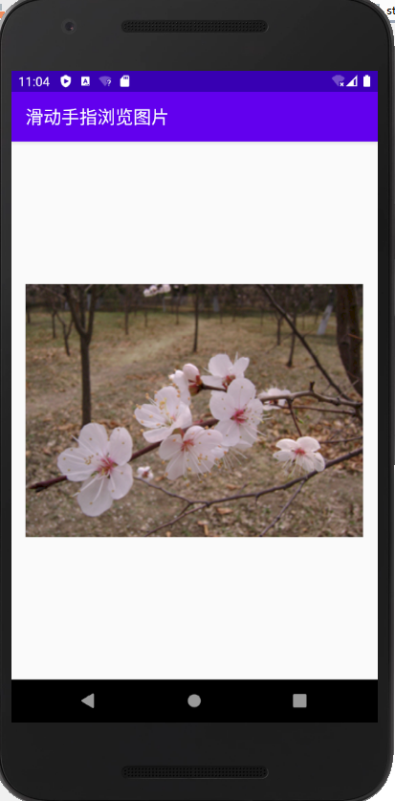
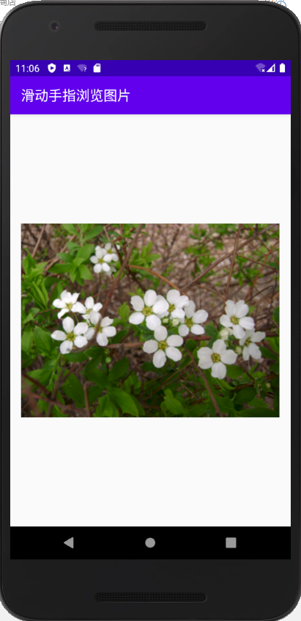
左右滑动手指浏览图片

Slide 25
activity_main.xml
<?xml version="1.0" encoding="utf-8"?>
<RelativeLayout
xmlns:android="http://schemas.android.com/apk/res/android"
xmlns:tools="http://schemas.android.com/tools"
android:layout_width="match_parent"
android:layout_height="match_parent"
android:padding="16dp"
tools:context=".MainActivity">
<ViewFlipper
android:id="@+id/flipper"
android:layout_width="match_parent"
android:layout_height="match_parent">
</ViewFlipper>
</RelativeLayout>

Slide 26
package nchu.bme.browseimage;
import androidx.appcompat.app.AppCompatActivity;
import android.gesture.Gesture;
import android.os.Bundle;
import android.view.GestureDetector;
import android.view.MotionEvent;
import android.view.View;
import android.view.animation.Animation;
import android.view.animation.AnimationUtils;
import android.widget.ImageView;
import android.widget.Toast;
import android.widget.ViewFlipper;

Slide 27
public class MainActivity extends AppCompatActivity implements
GestureDetector.OnGestureListener {
ViewFlipper flipper; //定义ViewFlipper
GestureDetector detector; //定义手势检测器
Animation[] animation = new Animation[4];//定义动画数组
final int distance = 50; //定义手势动作两点之间最小距离
//定义图片数组
private int[] images = new int[]{R.drawable.img01,
R.drawable.img02,R.drawable.img03, R.drawable.img04,
R.drawable.img05, R.drawable.img06, R.drawable.img07,
R.drawable.img08,R.drawable.img09,
};

Slide 28
@Override
protected void onCreate(Bundle savedInstanceState) {
super.onCreate(savedInstanceState);
setContentView(R.layout.activity_main);
detector = new GestureDetector(this, this); //创建手势检测器
flipper = (ViewFlipper) findViewById(R.id.flipper); //获取ViewFlipper
for (int i = 0; i < images.length; i++) {
ImageView imageView = new ImageView(this); //创建图像组件
imageView.setImageResource(images[i]); //设置图片资源
flipper.addView(imageView); //加载图片
}
//初始化动画数组
animation[0]=AnimationUtils.loadAnimation(this,R.anim.slide_in_left);
animation[1]=AnimationUtils.loadAnimation(this,R.anim.slide_out_left);
animation[2]=AnimationUtils.loadAnimation(this,R.anim.slide_in_right);
animation[3]=AnimationUtils.loadAnimation(this,R.anim.slide_out_right);
}

Slide 29
@Override
public boolean onDown(MotionEvent e) {
return false;
}
@Override
public void onShowPress(MotionEvent e) {
}
@Override
public boolean onSingleTapUp(MotionEvent e) {
return false;
}
@Override
public boolean onScroll(MotionEvent e1, MotionEvent e2,
float distanceX, float distanceY) {
return false;
}
@Override
public void onLongPress(MotionEvent e) {
}

Slide 30
@Override
public boolean onFling(MotionEvent e1, MotionEvent e2,
float velocityX, float velocityY) {
//如果第一个触点事件的X坐标到第二个触点事件的X坐标的距离超过distance就是从右向左滑动
if (e1.getX() - e2.getX() > distance) { //起点坐标大于终点坐标，从右向左滑
//为flipper设置切换的动画效果
flipper.setInAnimation(animation[2]); //右进
flipper.setOutAnimation(animation[1]); //左出
flipper.showPrevious();
return true;
//如果第二个触点事件的X坐标到第一个触点事件的X坐标的距离超过distance就是从左向右滑动
} else if (e2.getX() - e1.getX() > distance) { //终点坐标大于起点坐标，从左向右滑
//为flipper设置切换的动画
flipper.setInAnimation(animation[0]); //左进
flipper.setOutAnimation(animation[3]); //右出
flipper.showNext();
return true;
}
return false;
}
@Override
public boolean onTouchEvent(MotionEvent event) {
//将该Activity上的触碰事件交给GestureDetector处理
return detector.onTouchEvent(event);
}
}

Slide 31
slide_in_left.xml
<?xml version="1.0" encoding="utf-8"?>
<set xmlns:android="http://schemas.android.com/apk/res/android">
<translate
android:toXDelta="0"
android:fromXDelta="-100%p"
android:duration="500"/>
</set>

Slide 32
slide_in_right.xml
<?xml version="1.0" encoding="utf-8"?>
<set xmlns:android="http://schemas.android.com/apk/res/android">
<translate
android:toXDelta="0"
android:fromXDelta="100%p"
android:duration="500" />
</set>

Slide 33
slide_out_left.xml
<?xml version="1.0" encoding="utf-8"?>
<set xmlns:android="http://schemas.android.com/apk/res/android">
<translate
android:fromXDelta="0"
android:toXDelta="-100%p"
android:duration="500"/>
</set>

Slide 34
slide_out_right.xml
<?xml version="1.0" encoding="utf-8"?>
<set xmlns:android="http://schemas.android.com/apk/res/android">
<translate
android:fromXDelta="0"
android:toXDelta="100%p"
android:duration="500" />
</set>

Slide 35
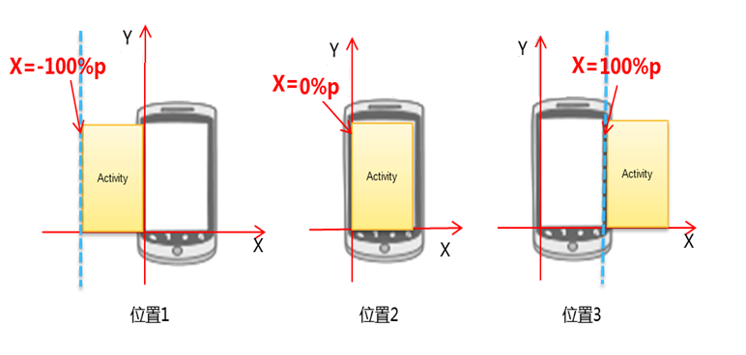

Slide 36
ViewFlipper(翻转视图)
ViewFlipper是Android自带的一个多页面管理控件，
用来实现进入应用后的引导页，或者用于图片轮播，可以自动播放！

Slide 37
翻转视图举例
自动图片浏览器

Slide 38
<?xml version="1.0" encoding="utf-8"?>
<LinearLayout xmlns:android="http://schemas.android.com/apk/res/android"
xmlns:app="http://schemas.android.com/apk/res-auto"
xmlns:tools="http://schemas.android.com/tools"
android:layout_width="match_parent"
android:layout_height="match_parent"
tools:context=".MainActivity"
android:orientation="horizontal"
android:padding="20dp">
<ViewFlipper
android:id="@+id/flipper"
android:layout_width="match_parent"
android:layout_height="match_parent"
></ViewFlipper>
</LinearLayout>

Slide 39
package nchu.bme.viewflipper_test;
import androidx.appcompat.app.AppCompatActivity;
import android.os.Bundle;
import android.view.animation.Animation;
import android.view.animation.AnimationUtils;
import android.widget.ImageView;
import android.widget.ViewFlipper;

Slide 40
public class MainActivity extends AppCompatActivity {
ViewFlipper flipper;
Animation[] animation=new Animation[4];
private int[] images=new int[]{R.drawable.i1,R.drawable.i2,R.drawable.i3,R.drawable.i4};
@Override
protected void onCreate(Bundle savedInstanceState) {
super.onCreate(savedInstanceState);
setContentView(R.layout.activity_main);
flipper=(ViewFlipper)findViewById(R.id.flipper);
for(int i=0;i<images.length;i++)
{
ImageView imageView=new ImageView(this);
imageView.setImageResource(images[i]);
flipper.addView(imageView);
}
flipper.setInAnimation(this,R.anim.slide_in_right);
flipper.setOutAnimation(this,R.anim.slide_out_left);
flipper.setFlipInterval(3000);
flipper.startFlipping();
animation[0]=AnimationUtils.loadAnimation(this,R.anim.slide_in_left);
animation[1]=AnimationUtils.loadAnimation(this,R.anim.slide_out_left);
animation[2]=AnimationUtils.loadAnimation(this,R.anim.slide_in_right);
animation[3]=AnimationUtils.loadAnimation(this,R.anim.slide_out_right);
}
}

Slide 41
slide_in_right.xml
<?xml version="1.0" encoding="utf-8"?>
<set xmlns:android="http://schemas.android.com/apk/res/android">
<translate
android:fromXDelta="100%p"
android:toXDelta="0"
android:duration="500" />
</set>

Slide 42
slide_out_left.xml
<?xml version="1.0" encoding="utf-8"?>
<set xmlns:android="http://schemas.android.com/apk/res/android">
<translate
android:fromXDelta="0"
android:toXDelta="-100%p"
android:duration="500"/>
</set>

Slide 43
举例：图片淡入淡出

Slide 44
<?xml version="1.0" encoding="utf-8"?>
<RelativeLayout
xmlns:android="http://schemas.android.com/apk/res/android"
xmlns:tools="http://schemas.android.com/tools"
android:layout_width="match_parent"
android:layout_height="match_parent"
tools:context=".MainActivity">
<ViewFlipper
android:id="@+id/flipper"
android:layout_width="match_parent"
android:layout_height="match_parent">
</ViewFlipper>
</RelativeLayout>

Slide 45
anim_alpha_in.xml
<?xml version="1.0" encoding="utf-8"?>
<set xmlns:android="http://schemas.android.com/apk/res/android">
<alpha android:fromAlpha="0"
android:toAlpha="1"
android:duration="4000"/>
</set>

Slide 46
anim_alpha_out.xml
<?xml version="1.0" encoding="utf-8"?>
<set xmlns:android="http://schemas.android.com/apk/res/android">
<alpha android:fromAlpha="1"
android:toAlpha="0"
android:duration="2000"/>
</set>

Slide 47
package nchu.bme.inout;
import androidx.appcompat.app.AppCompatActivity;
import android.os.Bundle;
import android.view.GestureDetector;
import android.view.MotionEvent;
import android.view.animation.Animation;
import android.view.animation.AnimationUtils;
import android.widget.ImageView;
import android.widget.ViewFlipper;

Slide 48
public class MainActivity extends AppCompatActivity
implements GestureDetector.OnGestureListener {
ViewFlipper flipper; //定义ViewFlipper
GestureDetector detector; //定义手势检测器
Animation[] animation = new Animation[2];
final int distance = 50; //定义手势动作两点之间最小距离
//定义图片数组
private int[] images = new int[]{
R.drawable.img01, R.drawable.img02, R.drawable.img03,
R.drawable.img04, R.drawable.img05, R.drawable.img06,
R.drawable.img07, R.drawable.img08, R.drawable.img09,
};

Slide 49
@Override
protected void onCreate(Bundle savedInstanceState) {
super.onCreate(savedInstanceState);
setContentView(R.layout.activity_main);
detector = new GestureDetector(this, this); //创建手势检测器
flipper = (ViewFlipper) findViewById(R.id.flipper); //获取ViewFlipper
for (int i = 0; i < images.length; i++) {
ImageView imageView = new ImageView(this);
imageView.setImageResource(images[i]);
flipper.addView(imageView); //加载图片
}
//初始化动画数组
animation[0] = AnimationUtils.loadAnimation(this, R.anim.anim_alpha_in); //淡入动画
animation[1] = AnimationUtils.loadAnimation(this, R.anim.anim_alpha_out); //淡出动画
}

Slide 50
@Override
public boolean onFling(MotionEvent e1, MotionEvent e2,
float velocityX, float velocityY) {
//为flipper设置切换的动画效果
flipper.setInAnimation(animation[0]);
flipper.setOutAnimation(animation[1]);
//如果第一个触点事件的X坐标到第二个触点事件的X坐标的距离超过distance就是从右向左滑动
if (e1.getX() - e2.getX() > distance) {
flipper.showNext();
return true;
//如果第二个触点事件的X坐标到第一个触点事件的X坐标的距离超过distance就是从左向右滑动
} else if (e2.getX() - e1.getX() > distance) {
flipper.showPrevious();
return true;
}
return false;
}
@Override
public boolean onTouchEvent(MotionEvent event) {
//将当前Activity上的触碰事件交给GestureDetector处理
return detector.onTouchEvent(event);
}
}

